Slide 1
Association of International Women in Malmö

Slide 2
How to make PEOPLE feel SEEN. Questioning and choose the leaderships style. Debate to negociate. Intergenerational communication. Intercultural understanding. Working with metaphors to advocate for your cause.
Tools for leadership and advocacy

Slide 3
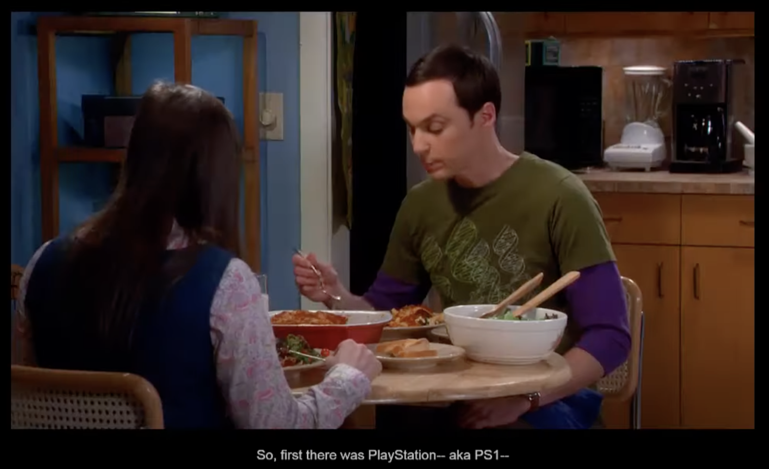
Make people feel SEEN and HEARD

Slide 6
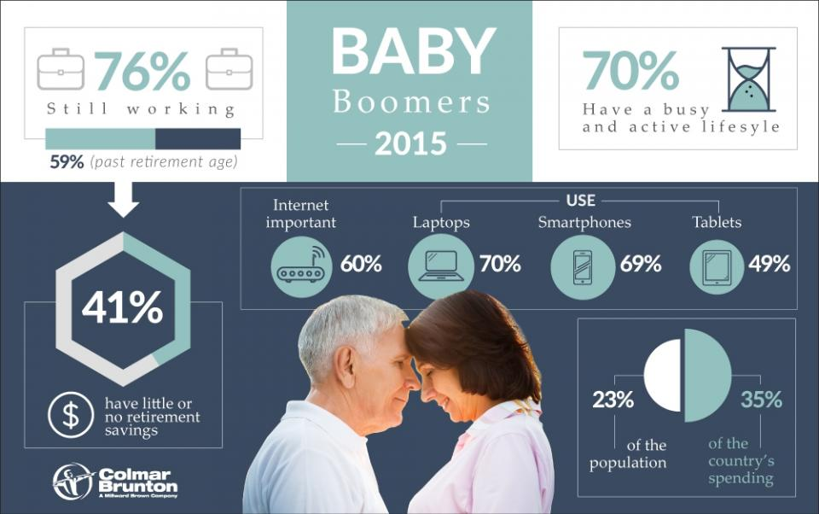
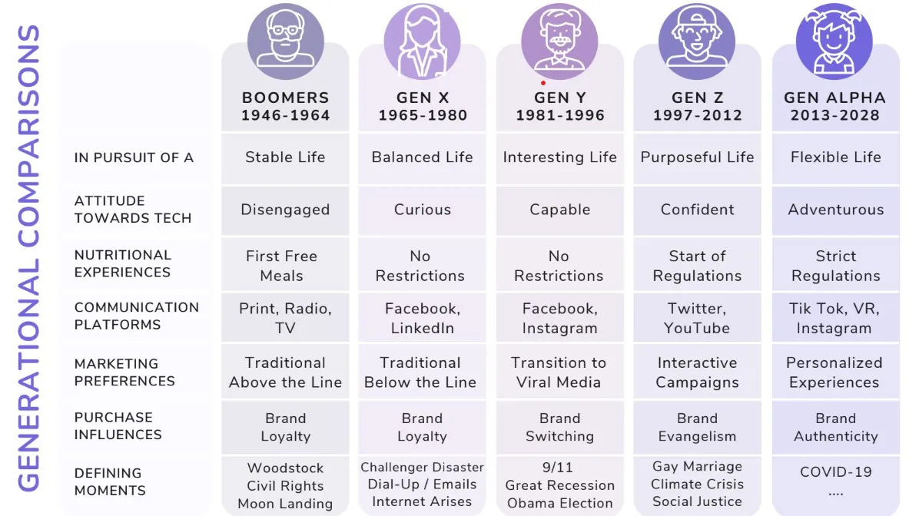
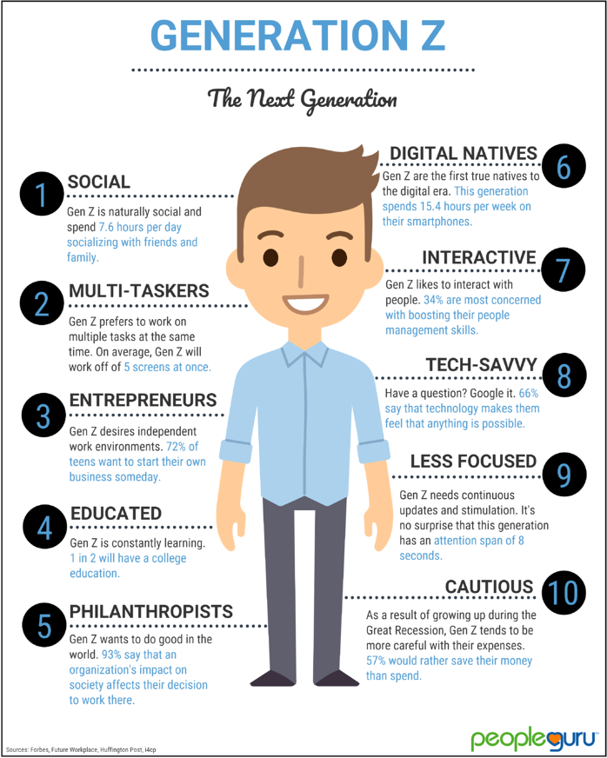
Intergenerational communication

Slide 7
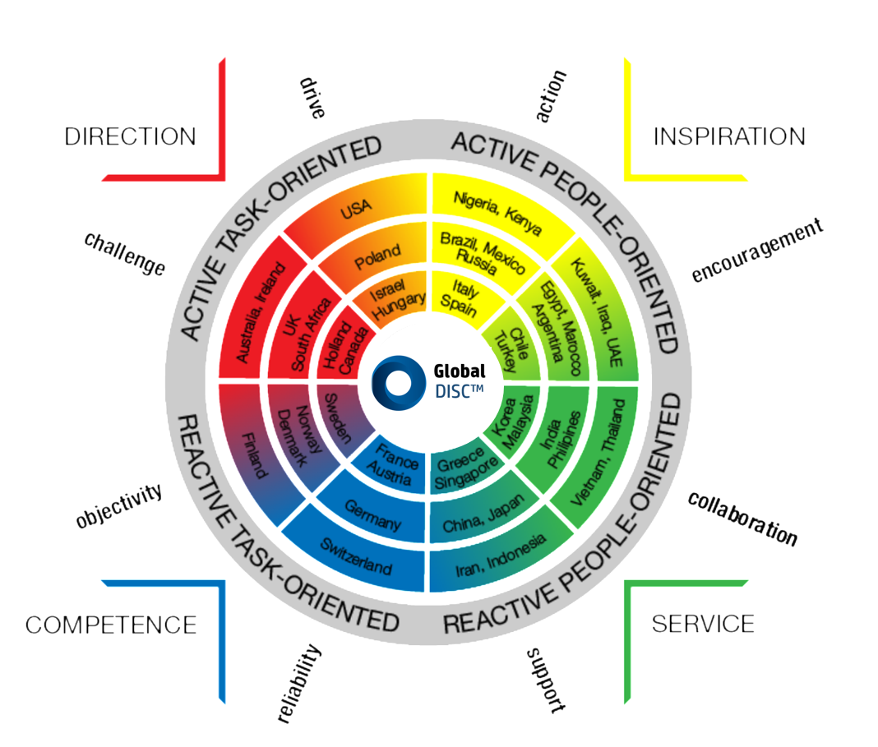
Intercultural understanding
Culture is the set of behaviours
and habits a person have.

Slide 8
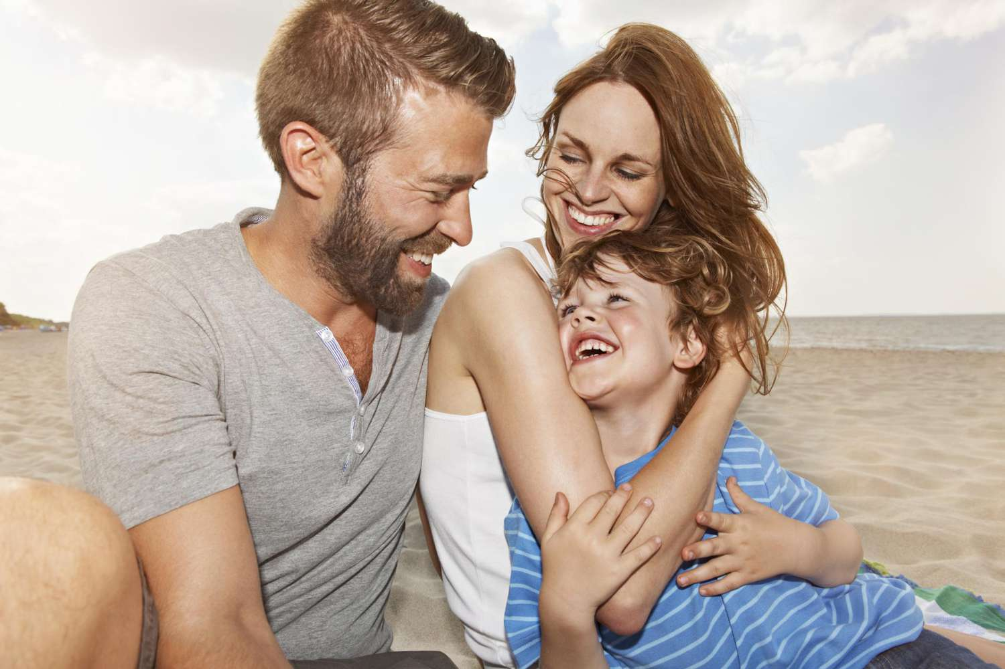
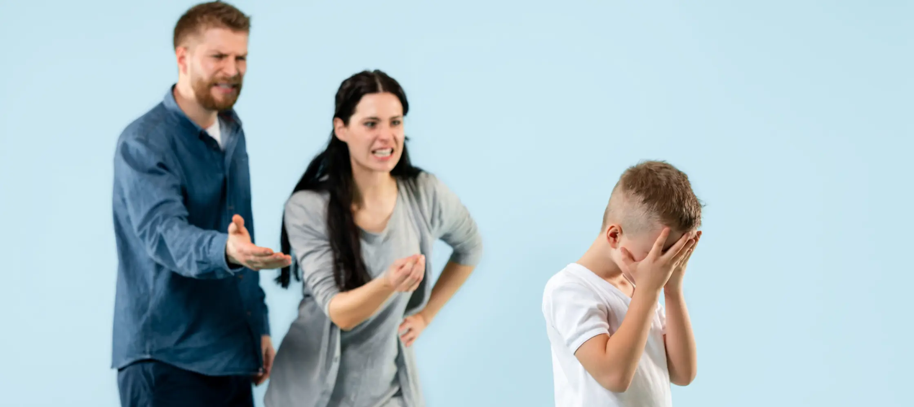
Metaphors
https://www.youtube.com/watch?v=RytyWu3zUq8

Slide 9
CONTACT
info@ikf.se
040 231 380
Grynbodgatan 20, 211 33 Malmö
@ikfmalmo
@Internationella Kvinnoföreningen i Malmö
@Internationella Kvinnoföreningen i Malmö
www.ikf.se

