Slide 1
I International Training on Youth Advocacy and Leadership
2-5 February in Narva, Estonia

Slide 2
AGENDA
02.02.2023, Thursday – Introduction 10:00 -12:00 Arrival and registration of Estonian and non-Estonian delegates in Tallinn 12.00 – 16.30 Visiting Tallinn City 16.30 – 16.45 Meeting in front of the Tallink Spa Hotell (Sadama 11a) 17.00 – 20.00 Departure from hotel to Narva 18.00 – 20.00 Practical group work task in the bus on the way to Narva. 20.00 – 22.00 Dinner + Formal opening of the International Training Meeting in Narva Hotel.
03.02.2023, Friday – Strategic dialogue and Youth Leadership / Capability Training for Young Leaders Part I 10.00 - 13.00 Participation in the international conference (Grant room) 13.00 - 14.00 Lunch 14.00 - 14.10 Purpose of the international training-meeting and division of the young people into working groups to work on one of the sections of the final outcome – the Youth Advocacy Statement. (Studio room) 14.10 – 14.30 Presentations “Advocacy – what is it?” – Anna Lisa Strakova, University of Tartu and Triin Roos, Estonian Youth Council. 14.30 – 15.15 Leadership Training for Young Leaders I – Youth Leadership training (Goal Setting and Planning (Triin Roos & ENL) 15.15 – 16.00 Leadership Training for Young Leaders II – Change Management (Anneli Ohvril) 16.00 – 16.15 Coffee break 16.15 – 17.00 Leadership Training for Young Leaders II
– Self-leadership skills (Susanne Kallanvaara)
17.00 – 18.00 Sharing practical exercises on youth advocacy (Based on the Youth Advocacy Toolkit) or How to support sustainable development goals in my communities. 19.00 – 21.00 Gala Dinner
4.02.2023, Saturday – Practical part and strategic dialogue & Capability Training for Young Leaders Part II 07.00 – 08.20 Breakfast and departure the the venue (Meresuu Spa Hotel). 09.00 – 10.00 Practical part: meeting with a youth advocacy expert/Visit to a youth advocacy-led NGO. (Vitatiim, SSCW, Sosialistisk Ungdom and Femina) 10:00 – 12.00 Keynote speeches and first dialogue session on intercultural dialogue – structured dialogue on the topic with keynote speakers followed by a working groups 12:00 – 13.00 Strategic Dialogue using the World Café method – group discussions to initiate a strategic dialogue (dialogue with power and policy makers who deal with youth issues and promote youth well-being in their daily work). 12.00 – 13.00 Youth Advocacy Statement Process/Strategic Dialogue – participants will share their experiences and knowledge on the assigned topic and conduct the first group exercises/questionnaire. 13:00 – 14:00 Lunch 14:00 – 15:00 Process of preparing the Youth Advocacy Call (Youth, experts and youth associations and officials). 15.00 – 16.00 Synthesis of the results of the strategic dialogue and summary of the practice. 16.00 – 20.00 Estonian culture program
05.02.2023, Sunday – Conclusions 09.00 – 10.00 Presentation of the results (overview of the training learnt and practical skills acquired). 10.00 – 11.00 Presentation of the youth advocacy appeal and the strategic plan. 12.00 – 15.00 Conclusions, visiting Narva Castle and Lunch
15.00 .... DEPARTURE
Dates: 2nd – 5th February 2023
Where: Vaba Lava Narva, Linda 2, 20309 Narva
Meresuu Spa Hotel, Aia 48a, Narva-Jõesuu
Event website: https://conference.sscw.ee/agenda/youth-advocacy/
The Local host: Sillamae Society for Child Welfare

Slide 3
Advocacy
ⓘ Start presenting to display the poll results on this slide.

Slide 4
Advocacy
Anna Lisa Strakova, University of Tartu

Slide 5
Youth Leadership training
Triin Roos, Estonian Youth Council

Slide 6
Change Management
Anneli Ohvril, Let's Do It World

Slide 7
Self-leadership skills
Susanne Kallanvaara, Burgårdens gymnasium

Slide 8
Youth Declaration
Laura Maria Rajala, Femina ry

Slide 9
Youth Declaration
ⓘ Start presenting to display the poll results on this slide.

Slide 10
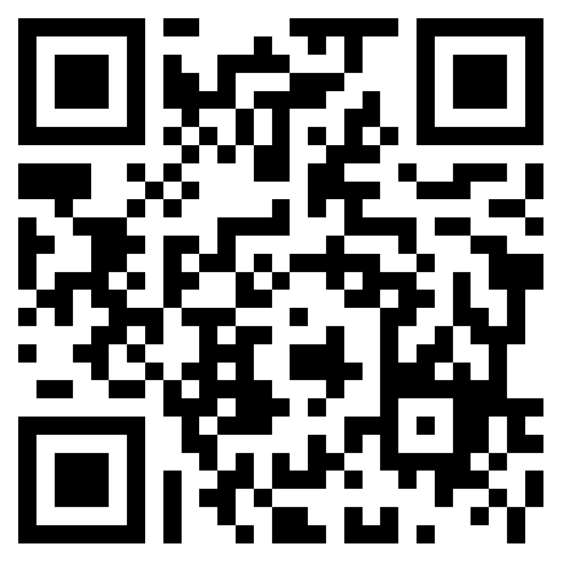
Feedback
Dear Participants,
Please fill out the feedback form by answering the questions asked.
This will not take more than
5 minutes, but it will help us evaluate the work done and improve the result in the future!
Thank you for your contributions
https://forms.office.com/r/7xyxwKmauG

